Slide 1
Presentation begins
Topic
Host
Analog and digital transmission
Base band and Broadband transmission

Slide 2

What is web hosting?
Web hosting is an online service that allows you to publish your website files onto the internet.

Slide 3
Host
How does web hosting work?
Your web host is responsible for making sure your server is up and running.
Prevents any security breaches and store all your files, assets and databases onto the server.

Slide 4
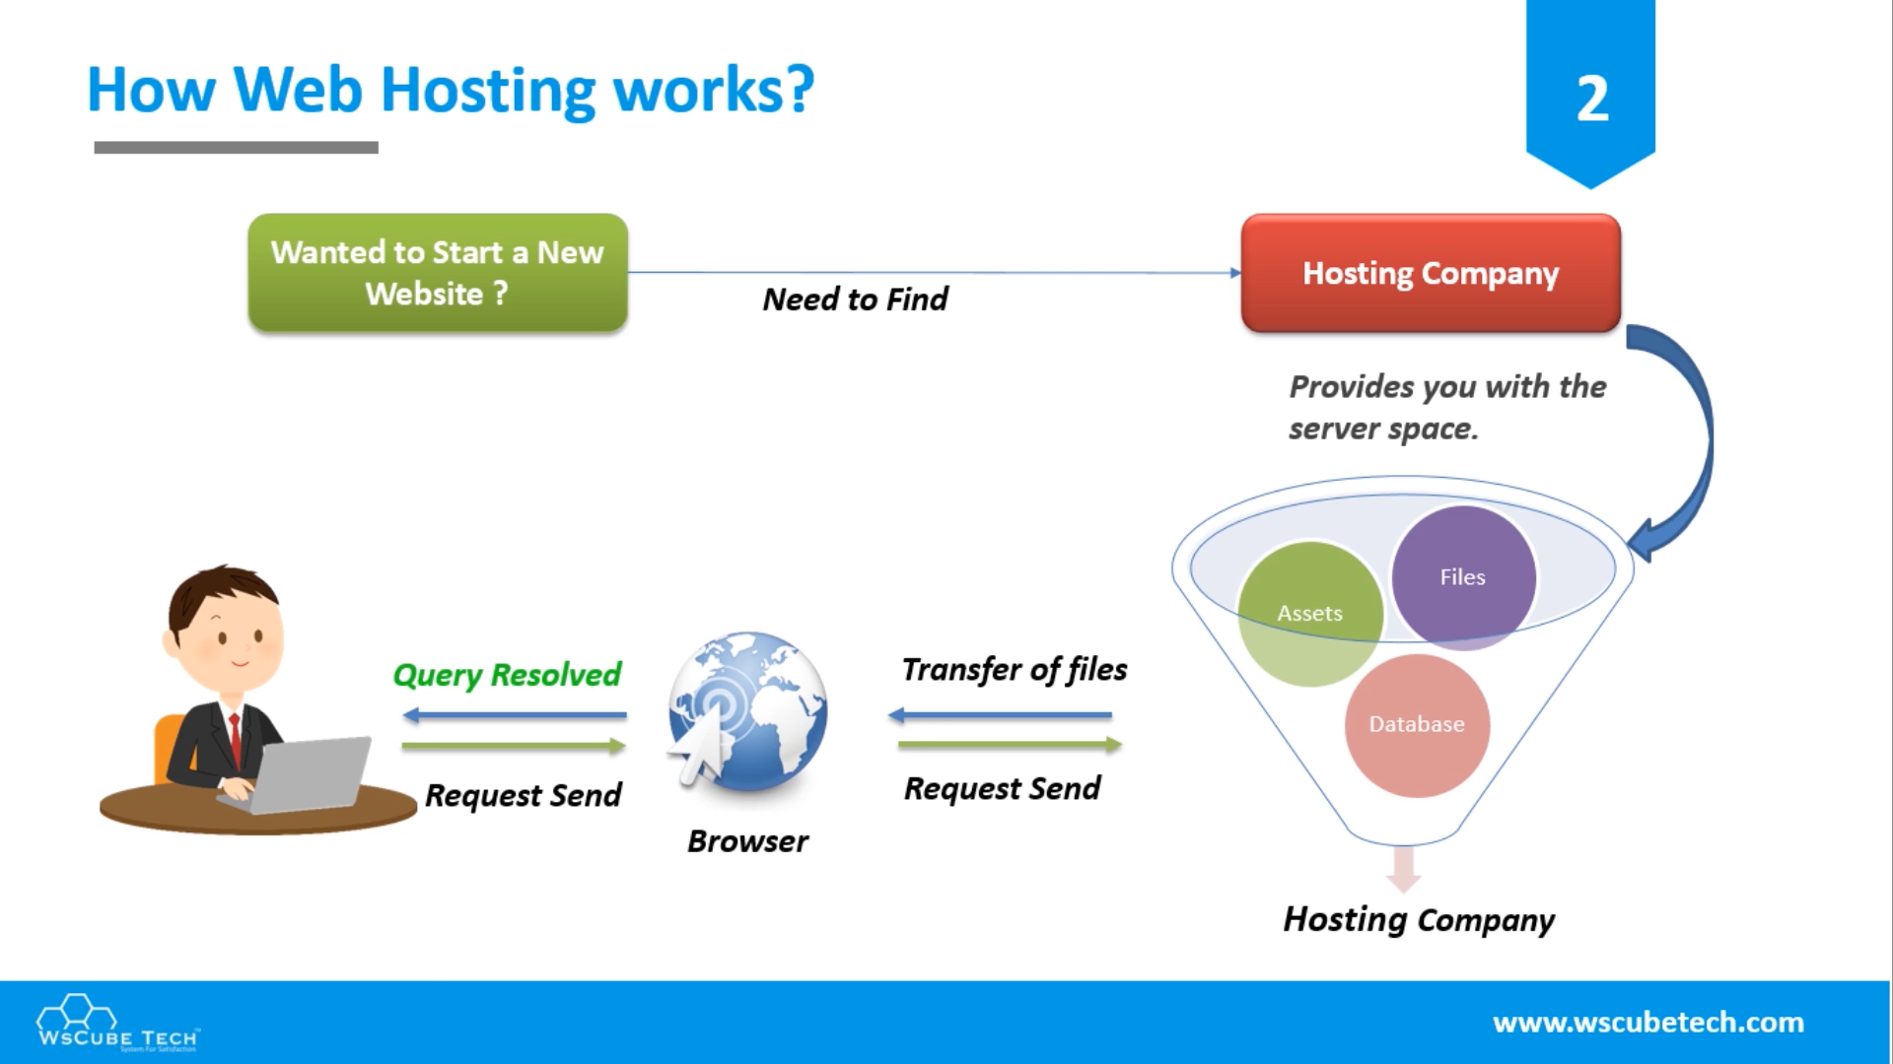

Slide 5
Types of web hosting
Shared Hosting
WordPress Hosting
VPS Hosting
Dedicated Hosting
Cloud Hosting

Slide 6


Slide 7


Slide 8


Slide 9


Slide 10
How much does website hosting cost?
Website hosting cost will vary by provider.
Free web hosting
Paid web hosting

Slide 11
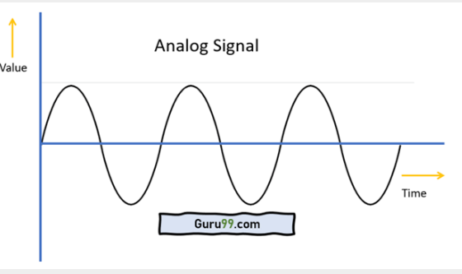
Analog Transmission
Concept
An analog wave form (or signal) is characterized by being continuously variable along amplitude and frequency.

Slide 12
Analog Transmission Advantages
Easier in processing
Best suited for audio and video transmission.
It has a low cost and is portable.
It has a much higher density so that it can present more refined information.
Not necessary to buy a new graphics board.
Uses less bandwidth than digital sounds
Provide more accurate representation of a sound
It is the natural form of a sound.

Slide 13
Analog Transmission Disadvantages
Analog tends to have a lower quality signal than digital.
The cables are sensitive to external influences.
The cost of the Analog wire is high and not easily portable.
Low availability of models with digital interfaces.
Recording analog sound on tape is quite expensive if the tape is damaged.
It offers limitations in editing.

Slide 14
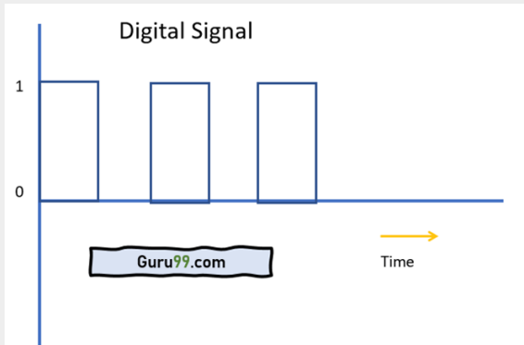
Digital Transmission Concept
● It is a series of discrete pulses, representing one bits and zero bits.

Slide 15
Digital Transmission Advantages
Digital data can be easily compressed.
Any information in the digital form can be encrypted.
Equipment that uses digital signals is more common and less expensive.
Digital signal makes running instruments free from observation errors like parallax and approximation errors.
A lot of editing tools are available
You can edit the sound without altering the original copy
Easy to transmit the data over networks

Slide 16
Digital Transmission Disadvantages
Sampling may cause loss of information.
A/D and D/A demands mixed-signal hardware
Processor speed is limited
Develop quantization and round-off errors
It requires greater bandwidth
Systems and processing is more complex.

Slide 17
3 Topic
Baseband and Broadband transmission

Slide 18
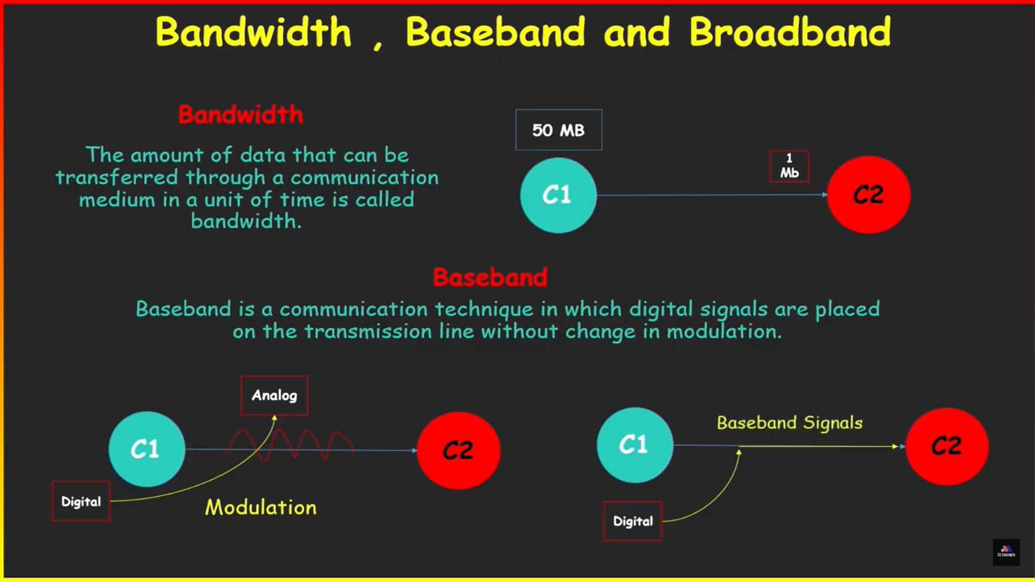

Slide 19
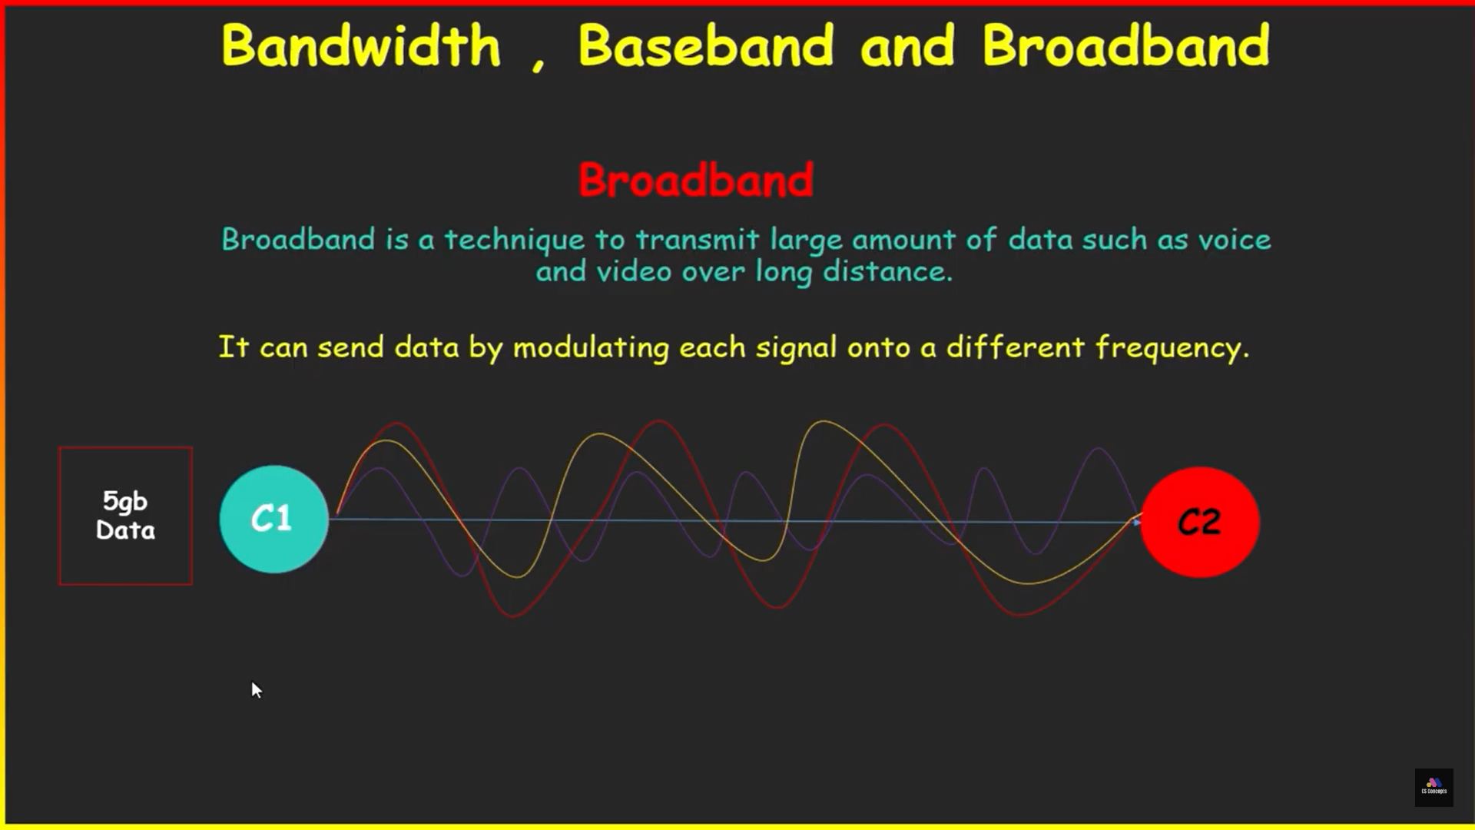

Slide 20
THANK YOU

